Slide 1







Ambassadorship Program Application
By Shurahbeel Peerzada

Slide 2
content.
01
INTRODUCTION
02
IDEAS
ENGAGING, CREATING VALUE AND PROMOTING
03
04
GAUGING EFFECTIVENESS

Slide 3
01
introduction.

Slide 4
introduction.
Hello, I'm Shurahbeel Peerzada, a junior year student at Ghulam Ishaq Khan Institute, pursuing a Bachelor's degree in Artificial Intelligence.
I am also a proud member of the Microsoft family, serving as a student ambassador for Microsoft Learn.Been part of technical societies during my time in GIKI
Throughout my time at GIKI, I've actively participated in various technical societies.
Moreover, I've held a position on the executive council of the Microsoft Club GIKI since my sophomore year.

Slide 5
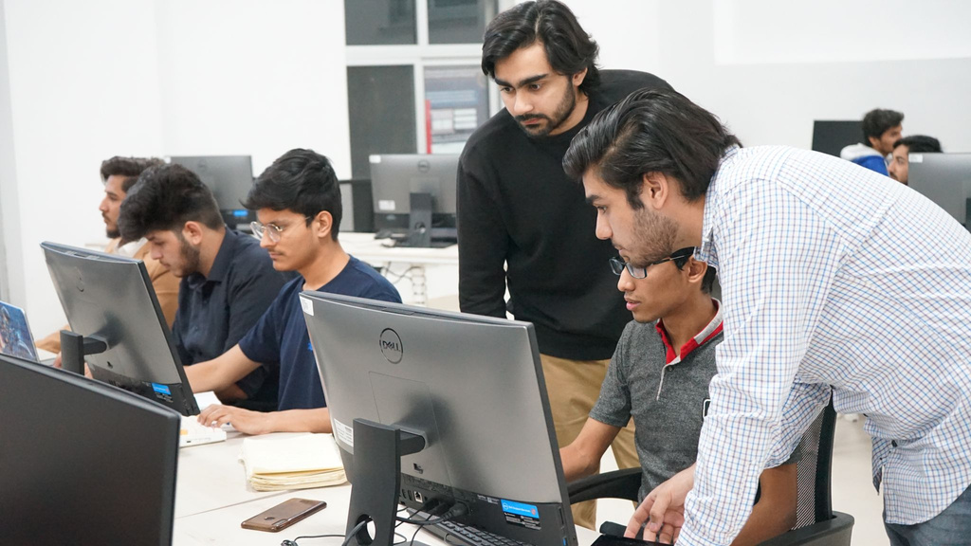
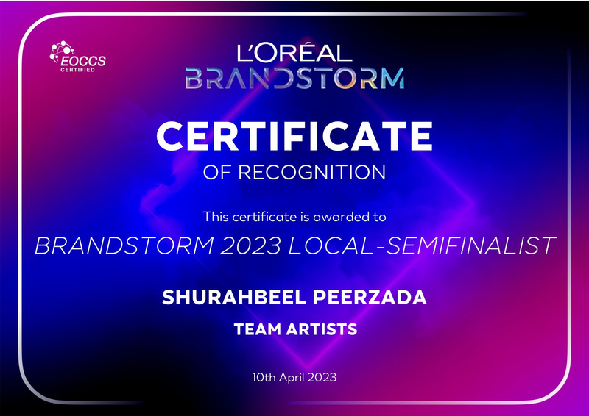
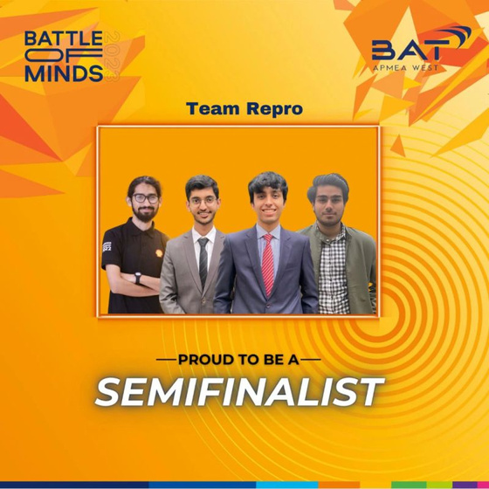
Activities
Hosted a hackathon as the head
L’OREAL brandstorm 23 National Semifinalist
BAT Battle of minds National Semifinalist 2023
Other Activities/Achievement:
Machine Learning Intern at Techlogix
Microsoft Learn Student Ambassador (Alpha)

Slide 6
02
Ideas

Slide 7

the idea.
My idea for the on campus activity is simple and hassle free.
As a member of the Microsoft Club GIKI's executive council, I help run the "Logikal" podcast, where we connect with industry experts and professors to share valuable insights. I am planning to host a podcast episode with Arbisoft, featuring a live audience of GIK students to have their questions answered.

Slide 8
a few other steps
In addition to the podcast idea, we have various other inclusive events within the Microsoft Club GIKI with which we can collaborate, such as our weekly learning and development sessions and an annual hackathon.
I can extend an invitation to Arbisoft specialists to host a session about their organization, introducing students to what Arbisoft represents. Furthermore, I find inspiration in the Juniper hackathons organized by Arbisoft, and I'm confident that many GIK students will be eager to participate, given their enthusiasm for such events. Even if a specialist isn't available, I can personally conduct an informative session about Arbisoft during our welcome parties for faculty.
This way, we ensure that the knowledge and opportunities provided by Arbisoft reach a wider audience at GIKI.
To further make things easier all of the events mentioned above are easily approved. The only condition to make these events happen are the approvals of advisor and dean for hall requisitions which is not a problem since we are conducting such events from start of our university.
Approval Process

Slide 9
03
Engaging, Creating Value and Promoting

Slide 10
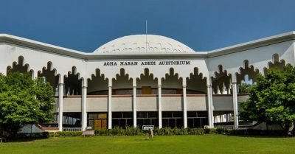
Engaging Students and Faculty
Our university is the first completely residential university of Pakistan so engaging the students and faculty isnt a big of a challenge. With prior door to door campaigning experience and pitching students during classes will allow me to gather interests of many.
I also have good relations with some of the renowned professors of the university and they most of the times themselves are present at such events hosted by corporates or companies. If I have to invite professors to an event I approach them with a formal invitation and request for their presence which I have been doing for the past year since we also need judges for club events.

Slide 11
creating value.
You might be thinking what would it be of advantage for Arbisoft to venture towards GIKI since GIKI’s biggest con is that it is in a remote place.
But let me fill you with some information, GIK has some of the top talented students that are worth investing in. For the past two years GIK has ranked number one in ICPC (Internation Collegiate Programming Competition) and last year sent two of its teams to Microsoft Imagine Cup where they were top 12 in National Finals.
I may have left out various other activities our students are actively engaged in, but the key message is that GIKI has the potential to supply Arbisoft with exceptional talent in the upcoming years. And with my ideas GIK students would have the opportunity to get hands on information from the specialists that will further boost their interest in Arbisoft.

Slide 12
promotion and social media.
The most used social media by date is Instagram, so I will start by using it to create a page “Arbisoft in GIKI” and create posts for Podcasts with Arbisoft professionals and other information relating Arbisoft to spread the word about it. I have prior experience with graphic designing as well.
I can boost the impressions of the page by collaborating with other societies as well because I have good relations with them and we tend to help each other out as well. As well as request our professors to reshare as their mails and messages are given priorities over the others.

Slide 13
04
gauging effectiveness

Slide 14
gauging the effectiveness
With my communication and convincing skills there will be no leaf unturned in making sure that there is a maximum attendance for such events.
For the podcast series we can gauge the effectiveness by using youtube analytics and making sure that a number of students are present in the live audience as well. Also we can run advertising for increasing reach as well.
For facts and figures we can resort to the analytics of Instagram posts and apart from that we can see how many students did participate in the junper hackathons.

Slide 15
thank you.
A presentation by Shurahbeel Peerzada

